Slide 1
CSE225: Data Structure and Algorithm Array, Pointer & Searching

Slide 2
Array
Declaration
Initialization
Accessing Array Elements
Inserting and Deleting in a Unsorted Array
Inserting and Deleting in a sorted Array

Slide 3
Linear Arrays
A linear array is a list of a finite number of n homogeneous data elements ( that is data elements of the same type) such that.
The elements are of the arrays are referenced respectively by an index set consisting of n consecutive numbers.
The elements of the arrays are stored respectively in successive memory locations.

Slide 4
Linear Arrays
The number n of elements is called the length or size of the array.
The index set consists of the integer 0,1, 2, …n-1
Length or the number of data elements of the array can be obtained from the index set by
Length = UB – LB + 1
where
UB is the largest index called the upper bound and
LB is the smallest index called the lower bound of the arrays

Slide 5
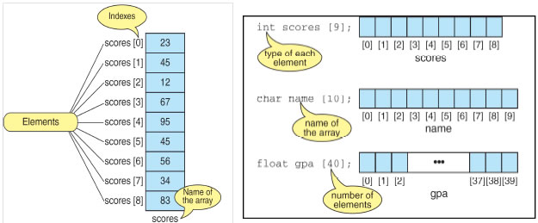
Linear Arrays
Element of an array A may be denoted by
Subscript notation A₁, A₂, , …. , A_{n}
Parenthesis notation A(1), A(2), …. , A(n)
Bracket notation A[1], A[2], ….. , A[n]
The number K in A[K] is called subscript or an index and A[K] is called a subscripted variable.

Slide 6
Declaring and Initializing Arrays
To declare an array:
data_type array_name[SIZE];
int ar_name[10]
data_type is a valid data type that must be common to all elements.
array_name is name given to array
SIZE is a constant value that defines array maximum capacity.
Initializing Arrays
Initialization of an array either one by one or using a single statement as follows −
int ar[5];
ar[0]=10; ar[1]=20;
double balance[5] = {1000.0, 2.0, 3.4, 7.0, 50.0};

Slide 7
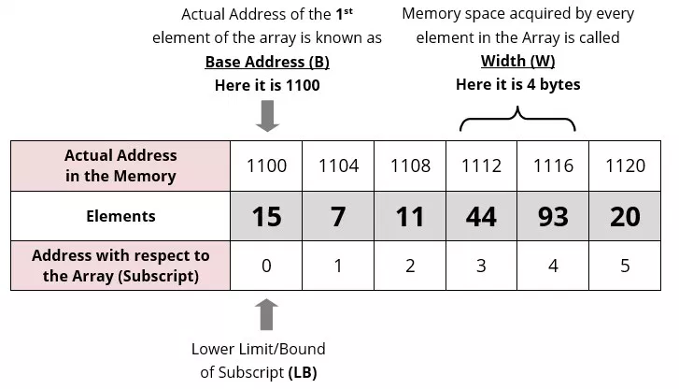
Representation of Linear Array in Memory
10

Slide 8
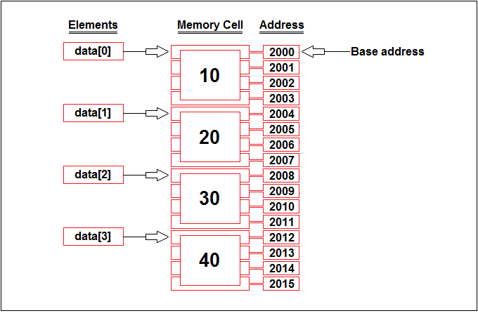
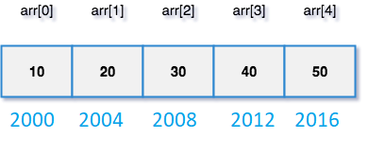
Representation of Linear Array in Memory

Slide 9
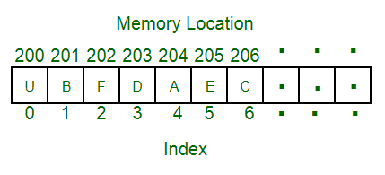
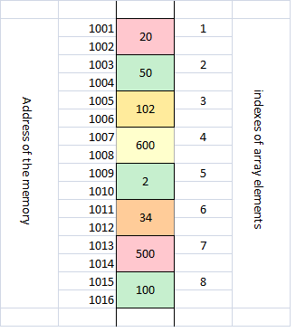
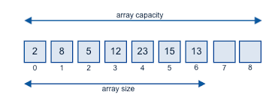
Representation of Linear Array in Memory

Slide 10
Representation of Linear Array in Memory
int LA[10]
Let
LA be a linear array in the memory of the computer.
LOC(LA[K]) = address of the element LA[K]
Computer does not keep track of the address of every element of the array
Keep track address of the first element of array
called the base address of LA and denoted by Base(LA)
LOC(LA[K]) = Base(LA) + w(K– lower bound)
where w is the number of words per memory cell

Slide 11
Example 1
Find the address for LA[6] Each element of the array occupy 1 byte
200
201
202
203
204
205
206
207
LA[1]
LA[2]
LA[3]
LA[4]
LA[5]
LA[6]
LA[7]
LA[8]
LOC(LA[K]) = Base(LA) + w(K – lower bound) :
LOC(LA[6]) = 200 + 1(6 – 1) = 205

Slide 12
Example 2
Find the address for LA[16] Each element of the array occupy 2 byte
200
201
202
203
204
205
206
207
LA[0]
LA[1]
LA[2]
LA[3]
LOC(LA[K]) = Base(LA) + w(K – lower bound) :
LOC(LA[16]) = 200 + 2(16 – 0) = 232

Slide 13
Searching Arrays
Linear search: Compare each element of array with key value
Search an array for a key value
Simple
Useful for small and unsorted arrays
Suppose you want to find a number in an unordered sequence
You have no choice – look through all elements until you have found a match
This is called linear or sequential search

Slide 14
Linear Search(LA,N, ITEM)
Linear Search (LA, N, ITEM) Here LA is a linear array with N elements. This algorithm find an element ITEM into the LA.
i=0
Repeat steps 3 and 4 while i>=n or LA[i]==ITEM
IF LA[i]==ITEM print item found at index i and exit
i=i+1
Print item not found and exit.
int search(int data[],int n, int item)
{
for(int i = 0; i<n; i++)
{
if(data[i] == item)
return i;
}
return -1;
}

Slide 15
Searching Arrays: Binary Search
Binary search
For sorted arrays
Compares middle element with key
If equal, match found
If key < middle, looks in first half of array
If key > middle, looks in last half
Repeat
Very fast; at most n steps, where 2^{n} > number of elements
30 element array takes at most 5 steps
2⁵ > 30 so at most 5 steps

Slide 16
Searching Arrays: Binary Search
int bsearch(int data[], int n, int value )
{
int first, middle, last;
first = 0;
last = n - 1;
while (true) {
middle = (first + last) / 2;
if (data[middle] == value)
return middle;
else if (first >= last)
return -1;
else if (value < data[middle])
last = middle - 1;
else
first = middle + 1;
}
}

Slide 17
Inserting in Unsorted Array
INSERT (LA, N, ITEM) Here LA is a linear array with N elements. This algorithm inserts an element ITEM into the LA.
If MAX==N, print overflow
Set LA[N] :=ITEM
[Reset N.] Set N := N + 1.
Exit.

Slide 18
Delete in Unsorted Array
DELETE (LA, N, k) Here LA is a linear array with N elements. This algorithm Delete the element ITEM from the LA.
Set LA[k] :=LA[N-1]
[Reset N.] Set N := N - 1.
Exit.

Slide 19
INSERT_SORTL (LA, N, K, ITEM)
Here LA is a sorted array with N elements and K is a positive integer such that K<N. This algorithm insert an element ITEM from the Kth position in LA.
1. j=N
2. Repeat step while LA[j]>ITEM;
3. Set LA[j]=LA[j-1]
4. Set LA[j]=ITEM
5. [Reset N.] Set N := N+1;
6. Exit.
0 | 10
1 | 20
2 | 25
3 | 30
4 | 40
5 | 45
6 | 50
7 | 60
8 | 70
9 | 80

Slide 20
DELETE_SORTL (LA, N, K, ITEM)
Here LA is a sorted array with N elements and K is a positive integer such that K<N. This algorithm Delete an element ITEM from the Kth position in LA.
1. SEARCH(LA, N, K, ITEM)
Set j : = k.
2. Repeat Steps 3 and 4 while .j <= n.
3. Move j^{th} element upward.
Set LA[j ] := LA[j+1].
4. [Decrease counter.] Set j:= j+1. [End of Step 2 loop.]
5. [Reset N.] Set N := N-1;
6. Exit.
0 | 10
1 | 20
2 | 30
3 | 50
4 | 60
5 | 70
6 | 80
7 | 80

Slide 21
Multidimensional Array
One-Dimensional Array
Two-Dimensional Array
Three-Dimensional Array
Some programming Language allows as many as 7 dimension

Slide 22
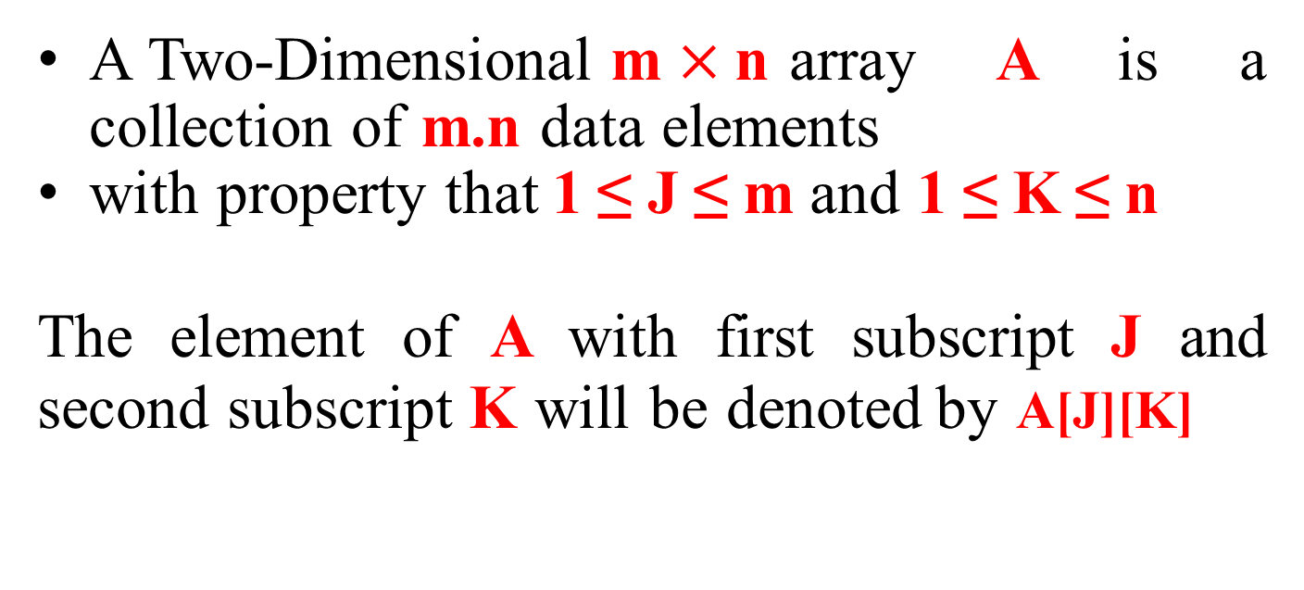
Two-Dimensional Array
A Two-Dimensional m $×$n array A is a collection of m.n data elements
with property that 1 ≤ J ≤ m and 1 ≤ K ≤ n
The element of A with first subscript J and second subscript K will be denoted by A[J][K]

Slide 23
2D Arrays
The elements of a 2-dimensional array a is shown as below
a[0][0]
a[1][0]
a[2][0]
a[0][1]
a[1][1]
a[2][1]
a[0][2]
a[1][2]
a[2][2]
a[0][3]
a[1][3]
a[2][3]

Slide 24
Rows Of A 2D Array
a[0][0]
a[1][0]
a[2][0]
a[0][1]
a[1][1]
a[2][1]
a[0][2]
a[1][2]
a[2][2]
a[0][3]
a[1][3]
a[2][3]
row 0
row 1
row 2

Slide 25
Columns Of A 2D Array
a[0][0]
a[1][0]
a[2][0]
a[0][1]
a[1][1]
a[2][1]
a[0][2]
a[1][2]
a[2][2]
a[0][3]
a[1][3]
a[2][3]
column 0
column 1
_{column 2} column 3

Slide 26
2D Array
Let A be a two-dimensional array m x n
The array A will be represented in the memory by a block of m x n sequential memory location
Programming language will store array A either
Column by Column
(Called Column-Major Order) Ex: Fortran, MATLAB
Row by Row
(Called Row-Major Order) Ex: C, C++ , Java

Slide 27
2D Array in Memory
A Subscript
 | (1,1)
 | ^{(2,1)} Column
 | (3,1)
 | (1,2)
 | (2,2) _{Colum}
 | (3,2)
 | (1,3)
 | (2,3) Colu
 | (3,3)
 | (1,4)
 | _{(2,4)} Colum
 | (3,4)
A | Subscript
 | (1,1)
 | (1,2) | Row 1
 | (1,3)
 | (1,4)
 | (2,1)
 | (2,2)
 | (2,3) | Row2
 | (2,4)
 | (3,1)
 | (3,2) | Row3
 | (3,3)
 | (3,4)
1
n 2
mn 3
n 4
Column-Major Order
Row-Major Order

Slide 28
What is a pointer variable?
A pointer variable is a variable whose value is the address of a location in memory.
To declare a pointer variable, you must specify the type of value that the pointer will point to.
For example,
int* ptr; // ptr will hold the address of an int
char* q; // q will hold the address of a char
Notes:
28

Slide 29
Using a pointer variable
2000
12
x
3000
2000
ptr
int x;
x = 12;
int* ptr;
ptr = &x;
NOTE: Because ptr holds the address of x,
we say that ptr “points to” x

Slide 30
Unary operator * is the deference (indirection) operator
2000
12
x
3000
2000
ptr
int x;
x = 12;
int* ptr;
ptr = &x;
std::cout << *ptr;
NOTE: The value pointed to by ptr is denoted by *ptr

Slide 31
Using the dereference operator
2000
12
x
3000
2000
ptr
int x;
x = 12;
int* ptr;
ptr = &x;
*ptr = 5;
// changes the value
// at adddress ptr to 5
5

Slide 32
Another Example
char ch;
ch = ‘A’;
char* q;
q = &ch;
*q = ‘Z’;
char* p;
p = q; // the right side has value 4000
// now p and q both point to ch
4000
A
ch
5000
4000
q
Z
6000
4000
p

Slide 33





Pointer dereferencing and member selection

Slide 34
Dynamically Allocated Data
char* ptr;
ptr = new char;
*ptr = ‘B’;
std::cout << *ptr;
2000
ptr
New is an operator
Notes:
34

Slide 35
Dynamically Allocated Data
char* ptr;
ptr = new char;
*ptr = ‘B’;
std::cout << *ptr;
NOTE: Dynamic data has no variable name
2000
ptr
Notes:
35

Slide 36
Dynamically Allocated Data
char* ptr;
ptr = new char;
*ptr = ‘B’;
std::cout << *ptr;
2000
ptr
‘B’
Notes:
36

Slide 37
Dynamically Allocated Data
char* ptr;
ptr = new char;
*ptr = ‘B’;
std::cout << *ptr;
delete ptr;
2000
ptr
NOTE:
Delete deallocates the memory pointed to by ptr.
?
Notes:
37

Slide 38
what does new do?
takes a pointer variable,
allocates memory for it to point, and
leaves the address of the assigned memory in the pointer variable.
If there is no more memory, the pointer variable is set to NULL.

Slide 39
The NULL Pointer
There is a pointer constant called NULL available in cstddef.
NULL is not a memory address;
it means that the pointer variable points to nothing.
It is an error to dereference a pointer whose value is NULL.
It is the programmer’s job to check for this.
while (ptr != NULL)
{
. . . // ok to use *ptr here
}

Slide 40
What happens here?
3
ptr
int* ptr = new int;
*ptr = 3;
ptr = new int; // changes value of ptr
*ptr = 4;
3
ptr
4
Notes:
40

Slide 41
Memory Leak
A memory leak occurs when dynamic memory (that was created using operator new) has been left without a pointer to it by the programmer, and so is inaccessible.
int* ptr = new int;
*ptr = 8;
int* ptr2 = new int;
*ptr2 = -5;
8
ptr
-5
ptr2
How else can an object become inaccessible?
Notes:
41

Slide 42
Causing a Memory Leak
8
ptr
-5
ptr2
int* ptr = new int;
*ptr = 8;
int* ptr2 = new int;
*ptr2 = -5;
ptr = ptr2;
// here the 8 becomes inaccessible
8
ptr
-5
ptr2
Notes:
42

Slide 43
Using operator delete
The object or array currently pointed to by the pointer is deallocated, and the pointer is considered unassigned.
The memory is returned to the free store.
Square brackets are used with delete to deallocate a dynamically allocated array of classes.
Notes:
43

Slide 44
A Dangling Pointer
occurs when two pointers point to the same object and delete is applied to one of them.
int* ptr = new int;
*ptr = 8;
int* ptr2 = new int;
*ptr2 = -5;
ptr = ptr2;
8
ptr
-5
ptr2
Notes:
44

Slide 45
Leaving a Dangling Pointer
8
ptr
-5
ptr2
int* ptr = new int;
*ptr = 8;
int* ptr2 = new int;
*ptr2 = -5;
ptr = ptr2;
delete ptr2; // ptr is left dangling
ptr2 = NULL;
8
ptr
NULL
ptr2
Notes:
45

Slide 46
Using Pointer and Reference in the parameter of a Function
Using Pointer
Using Reference
void change(int* i){
*i = 30;
}
int main(void){
int a = 40;
change(&a);
cout << a;
return 0;
}
void change(int& i){
i = 30;
}
int main(void){
int a = 40;
change(a);
cout << a;
return 0;
}
The parameter is a pointer;
Need to pass pointer in the argument by using the & sign
The parameter is a reference;
Can use the variable name directly

Slide 47
Remember?
A list is a homogeneous collection of elements, with a linear relationship between elements.
Each list element (except the first) has a unique predecessor, and
each element (except the last) has a unique successor.

